Slide 1
JWT Authentication 🔐
Spring Boot Complete Guide

Slide 2
The Problem 🤯
Copy-paste JWT
No understanding
Fail in interviews

Slide 3
What is JWT? 🧠
JSON Web Token
Stateless authentication
No session storage

Slide 4
JWT Structure ⚙️
Header
Payload
Signature

Slide 5
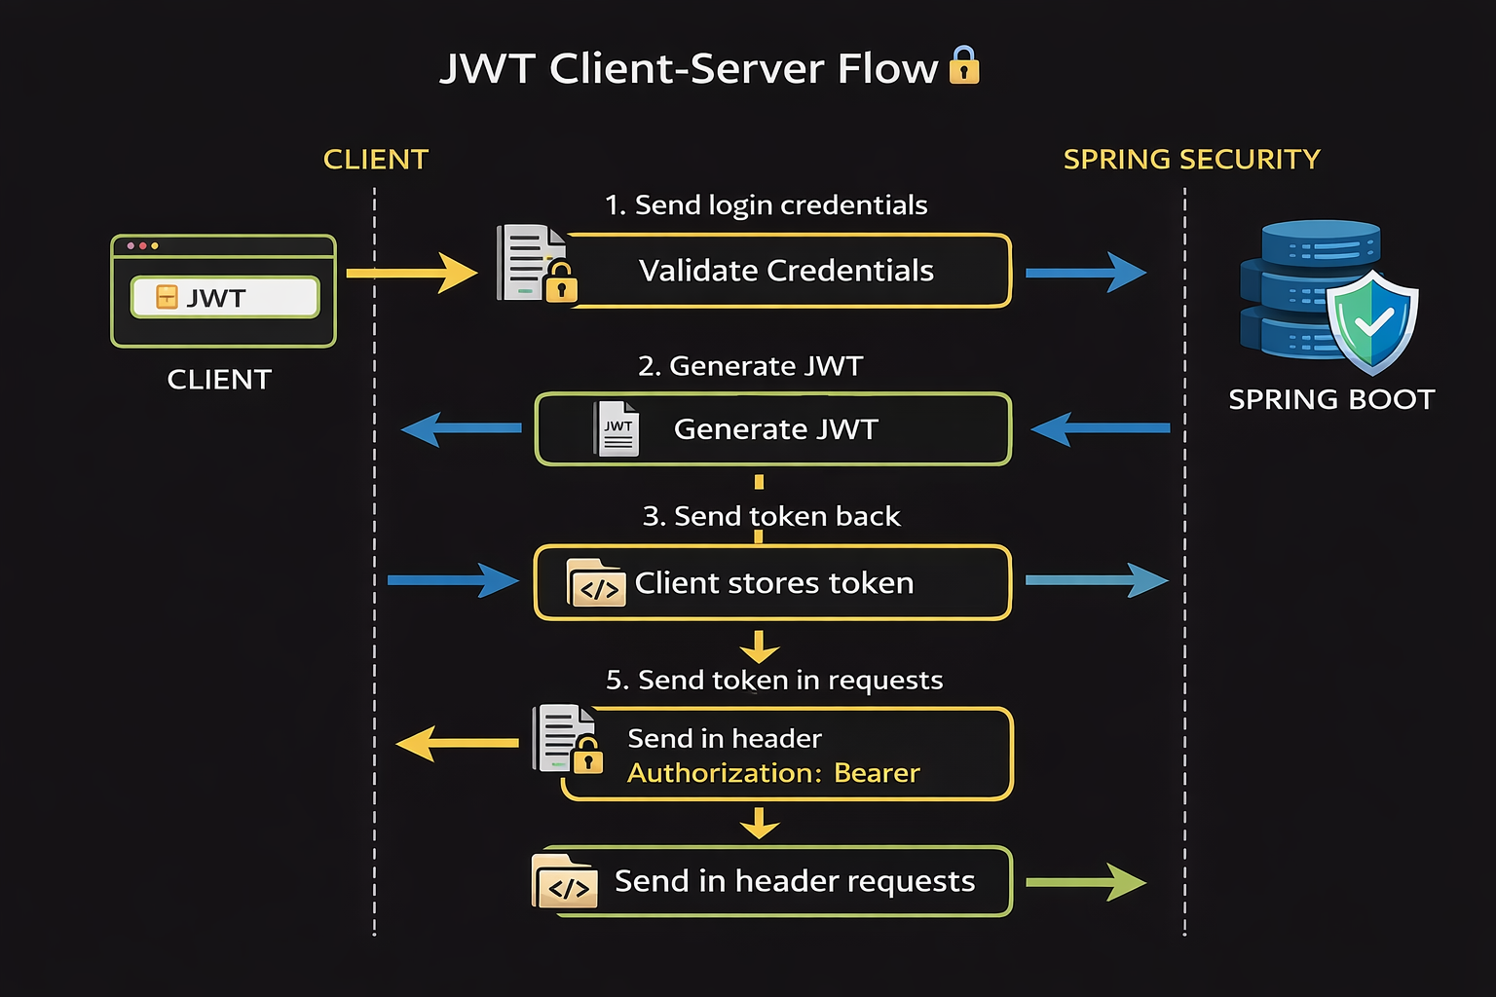

JWT Flow

Slide 6
JWT Flow

Slide 7
JWT Flow

Slide 8
JWT Flow

Slide 9
JWT Flow

Slide 10
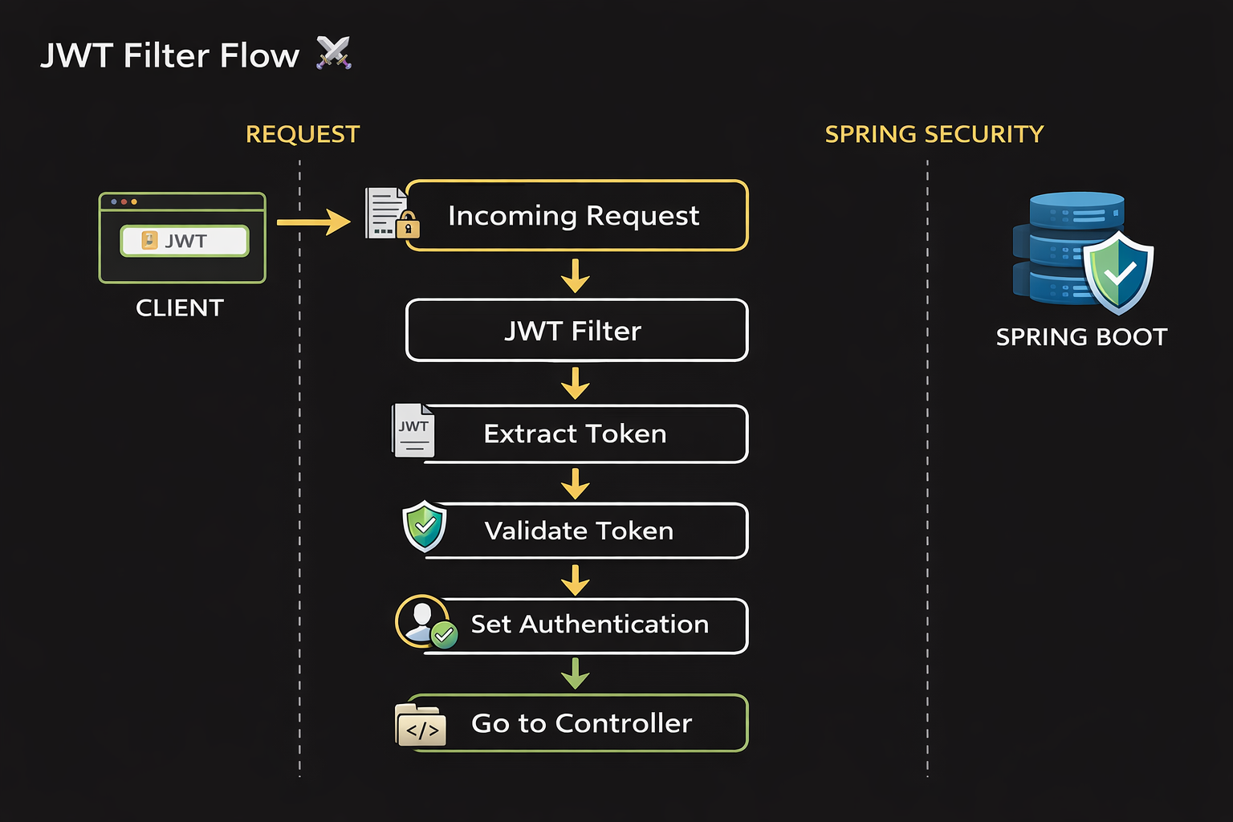
JWT Flow

Slide 11
JWT Flow

Slide 12
JWT Flow

Slide 13
JWT Flow

Slide 14
JWT Flow

Slide 15
JWT Flow

Slide 16
Spring Boot Implementation Flow 🔥
✅ Step 1: Add Dependencies

Slide 17
Spring Boot Implementation Flow 🔥
✅ Step 1: Add Dependencies
✅ Step 2: Create JWT Utility Class

Slide 18
Spring Boot Implementation Flow 🔥
✅ Step 1: Add Dependencies
✅ Step 2: Create JWT Utility Class
✅ Step 3: Create Authentication API

Slide 19
Spring Boot Implementation Flow 🔥
✅ Step 1: Add Dependencies
✅ Step 2: Create JWT Utility Class
✅ Step 3: Create Authentication API
✅ Step 4: Create Filter

Slide 20
Spring Boot Implementation Flow 🔥
✅ Step 1: Add Dependencies
✅ Step 2: Create JWT Utility Class
✅ Step 3: Create Authentication API
✅ Step 4: Create Filter
✅ Step 5: Configure Security

Slide 21
Common Mistakes ❌
Hardcoded secrets
No expiry handling
Ignoring filter

Slide 22
Interview Tip 💼
Explain flow clearly
Focus on WHY not code

Slide 23
Action Plan 🎯
Implement JWT
Debug step-by-step
Understand deeply

Slide 24
Final Message 🔥
Don't copy JWT
Understand it like a pro

